Slide 1
D103 Toastmasters
2025-2025 Club Realignment Report
September 27, 2025
Valerie Smith, DTM
District Director
Presenter

Slide 2
Club Realignment Objectives
Club Realignment Process
Number of Clubs Per Divisions
Why Division B was Dissolved

Slide 3
Club Realignment Process
Review each Division- Number of Clubs
Minimum of clubs per Division is 16
Maximum of clubs per Area are 6
Maximum of Areas in a Division: unlimited (according to TI-Districts Team)
When reviewing each Division and the Areas, go to the Toastmasters dashboard to check the club status for each Area; clubs above 8 club members or below 8 club members. When making recommendations for each Area: the first 4 strong clubs are entered in the Club Realignment Portal as Clubs 1-4, and if you have two weak clubs (either- dissolving, suspension or under 8 club members) will go under lines 5 & 6 if there are 6 clubs in that Area (just an example for the next Club Realignment Team)

Slide 4
Number of Clubs Per Division
The Club Realignment, voted on April 18, 2025, operated with only the bare minimum of 15–18 clubs per Division. After I, as District Director, reviewed the plan with the Realignment Committee following our emergency meeting after the July 15 deadline, adjustments were made by moving weaker clubs below the stronger clubs within each Area. On July 19, 2025, the District Executive Committee voted to dissolve Division B11; however, the Toastmasters International Districts Team did not approve the Club Alignment, because we were still operating at only the minimum number of clubs per Division. This ultimately led to the dissolution of Division B.

Slide 5
Number of Clubs Per Division (Continuation)
After Toastmasters International denied the alignment, I, as District Director, learned of the 16-club minimum requirement and realized that we were not starting the year with healthy Divisions. The recommendation from the Districts Team was to dissolve a Division and move its Areas and clubs into other Divisions to ensure each one began the year strong with 20 or more clubs.

Slide 6
Why Division B was Dissolve
Division B was dissolved, according to the Districts Team at Toastmasters International, to begin the year with healthy Divisions of 20+ clubs , which strengthens each one. This change encourages Area Directors to achieve Distinguished or higher status in their Areas, which in turn supports the Divisions in reaching Distinguished or better, thanks to the stronger clubs within each Division.

Slide 7
2025-2026 Club Realigment

Slide 8
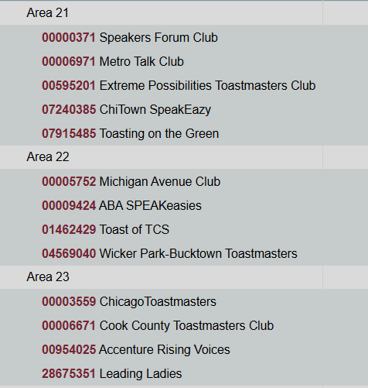
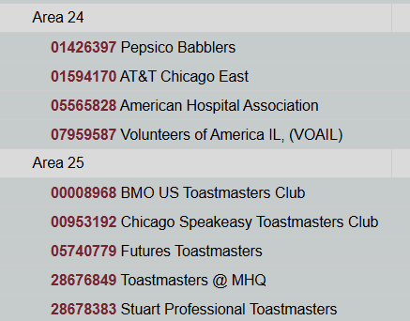
2025-2026 Club Realignment
Division (C) Central North: Areas: C21, C22, C23, C24 & C25
C25 is a New Area
(B12 – Moved to C25; added Chicago Speakeasy (formerly B11)

Slide 9
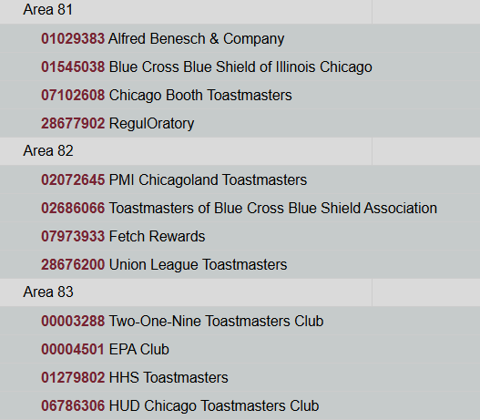
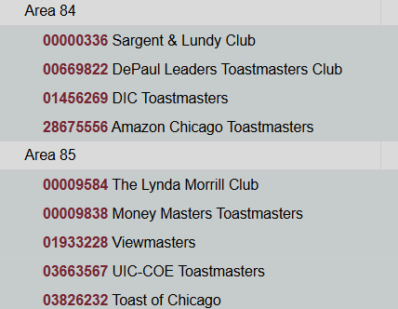
2025-2026 Club Realignment
Division (F) Central East: Areas: F81, F82, F83, F84 & F85
F85 is a New Area
B13 – Moved to F25; added UIC-COE Toastmasters (formerly B11)

Slide 10
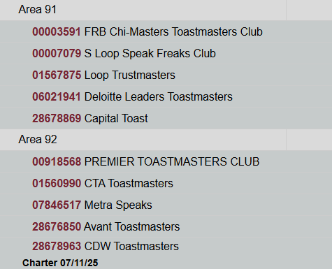
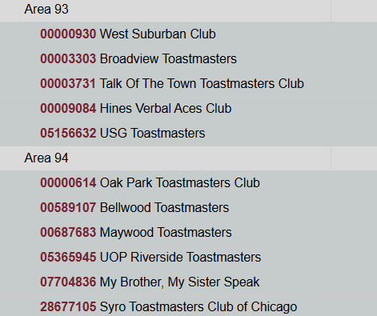
2025-2026 Club Realignment
Division (G) Central West: Areas: G91, G92, G93, G94
B14 – Moved to G91; added South Loop Speak Freaks (formerly B11)
New Charter Clubs:
Capital Toast TM Club: 6/25
CDW TM Club: 7/25
G91: emptied because MSI Toastmasters dissolved, USG TM Dissolved in August 2025, moved to G93, because G91 did not have clubs, Saturday Sunrise was moved to S52
G91: Was replace by clubs from former Area B14
G92: New Charter Club: CDW Toastmasters
UOP Toastmasters moved from G93 to G94

Slide 11
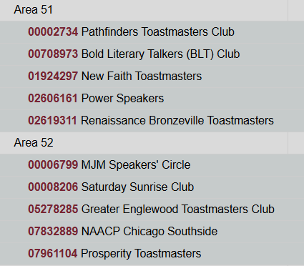
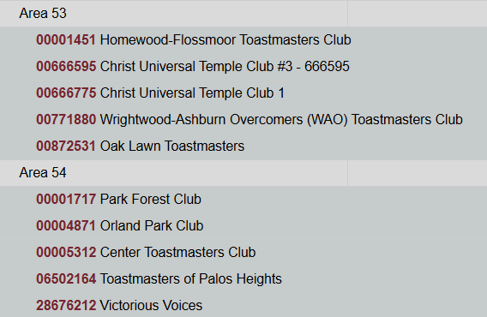
2025-2026 Club Realignment
Division (S) South: Areas: S51, S52, S53, S54
Homewood-Flossmoor Toastmasters Club: moved from Area S54 to Area S53
Prosperity Toastmasters moved from Area S51 to Area S52
Saturday Sunrise Club: Went from Division (G) G91 to Division (S) S52
New Faith Toastmasters moved from S52 to S51
Notes:
a

Slide 12
Toastmasters International Approved
2025-2026 Club Realignment on
July 22, 2025

Slide 13
Thank You

